Slide 1
Bussiness Insights on Post-COVID Taxi System
BY:
Onkar Eknath Shelar
Guided By:
Mrs. Suvrunda Nangare

Slide 2
Overview
Data Collection
Data Cleaning
Feature Engineering
Data Analysis
Building ML Models
Prediction
Deployment
Visualisation

Slide 3
DATA COLLECTION
Data collected from website NYC-Taxi and Limousine Commission (TLC). The URL is - https://www1.nyc.gov/site/tlc/about/tlc-trip-record-data.page
Steps:
Took mini-batches of Dataset from every month.
Found the co-ordinates of every borough and zones using geoPy
Joining both dataset to generate the final data set for the Algorithm
Our final dataset contains 27 features.

Slide 4
DATA CLEANING
Steps:
Removed the NULL values
Removed empty slots
Removed the data related to all the locations outside the NYC
Removed the records where count of passenger is in negative or more than 6
Removed the records where the fare generated is in negative

Slide 5
Feature Engineering
Changed the column names
Divided the column into suitable based on time
Adding features like weather related, trip to airport, trip during rush hours, trip during midnight
Calculating distance
Mathematical way
Programmatically

Slide 6
Data Analysis
Univariate Analysis
Bivariate Analysis

Slide 7
Building ML Models
Splitting the dataset into train-test set
Principal Component Analysis
Models used
Linear Regression
XGBoost
Random Forest

Slide 8
Prediction
Evaluating Models with following metrics:
R2 score
Mean Absolute Error
Mean Squared Error
Root Mean Squared Error
Predicting :
Fare Amount
Total Amount
Tip Amount

Slide 9
Deployment
Deployed on Used Flask, HTML, CSS
Deployed on AWS

Slide 10
Visualisation ( using Python )

Slide 11
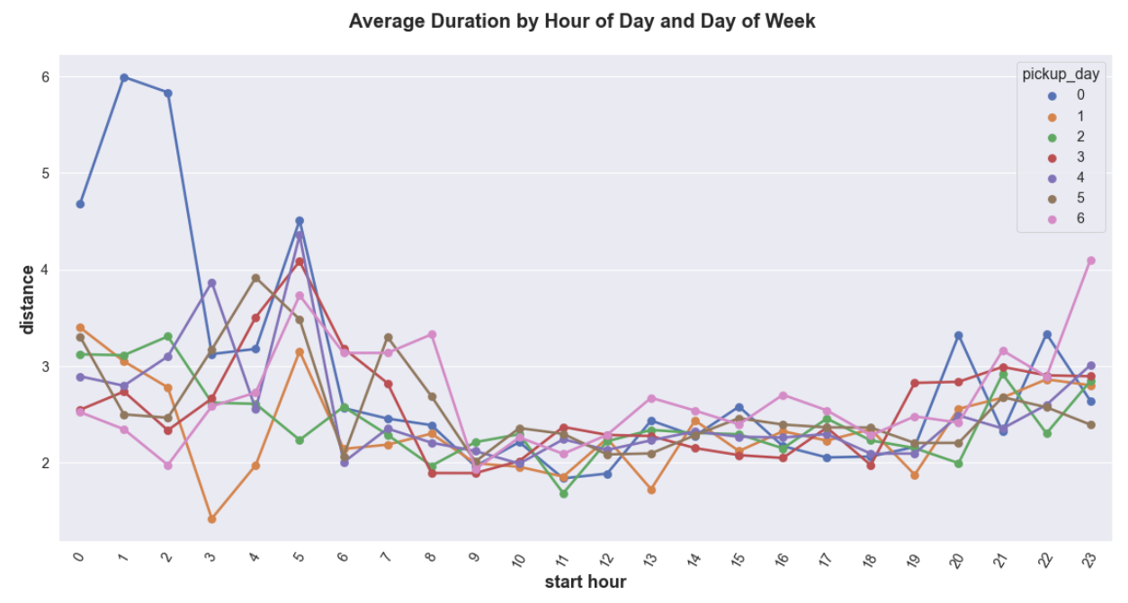

Slide 12
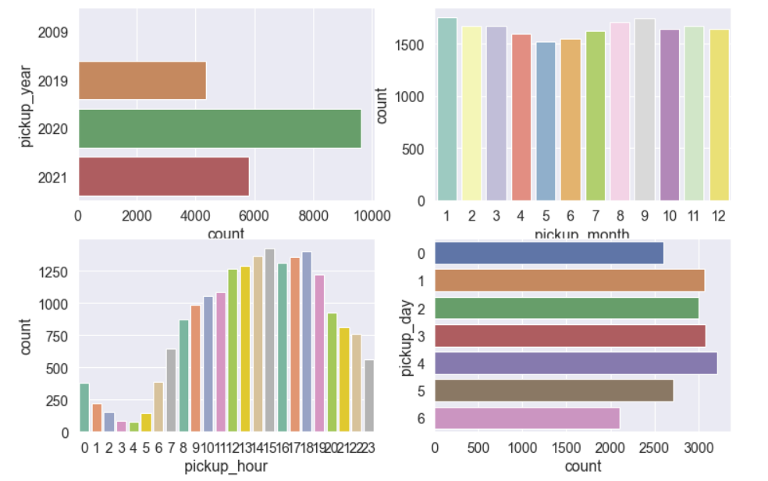

Slide 13
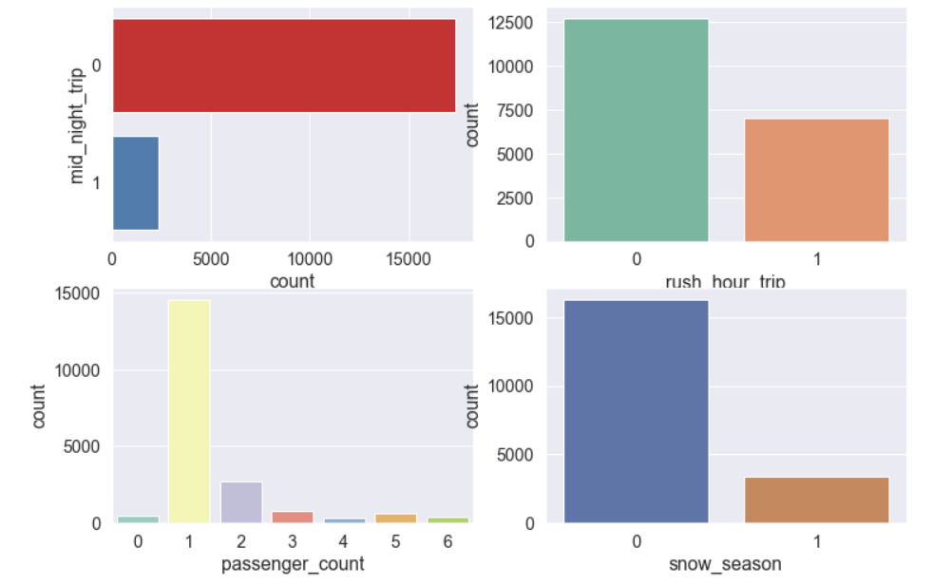

Slide 14
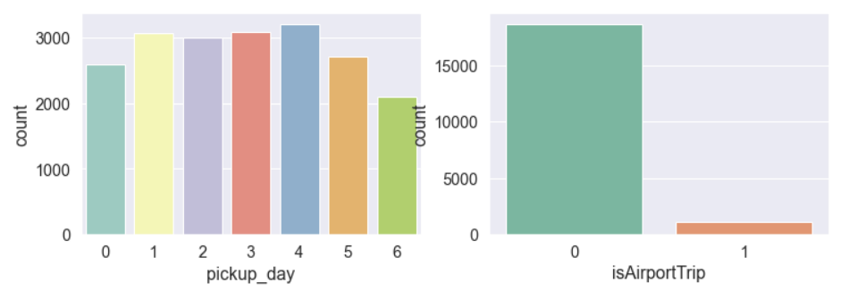
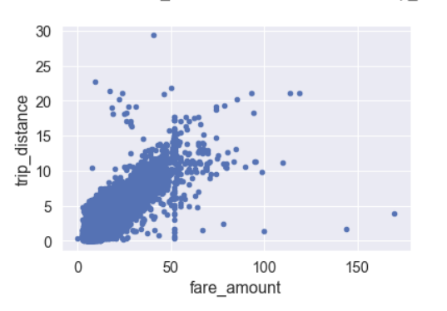

Slide 15
Presentation ( using PowerBI )

Slide 16
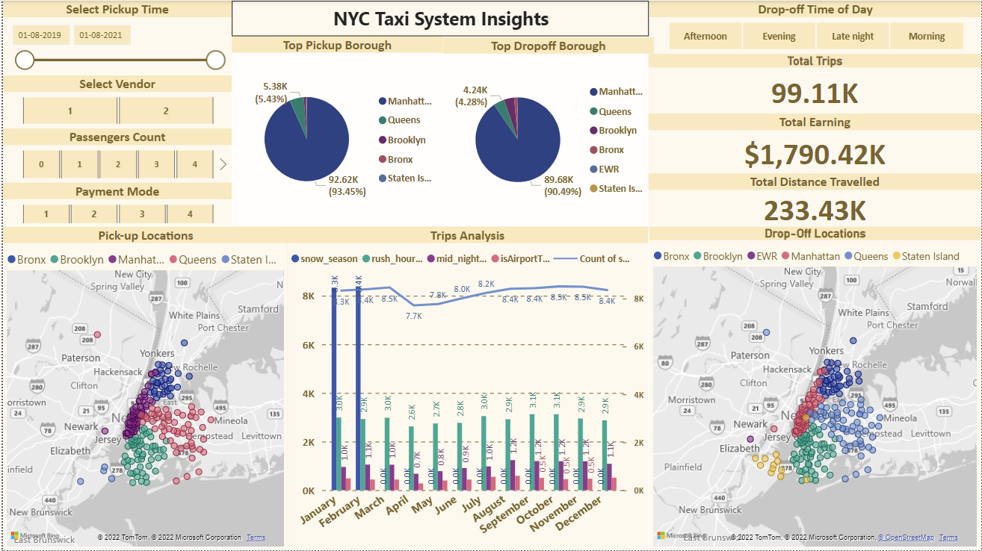

Slide 17
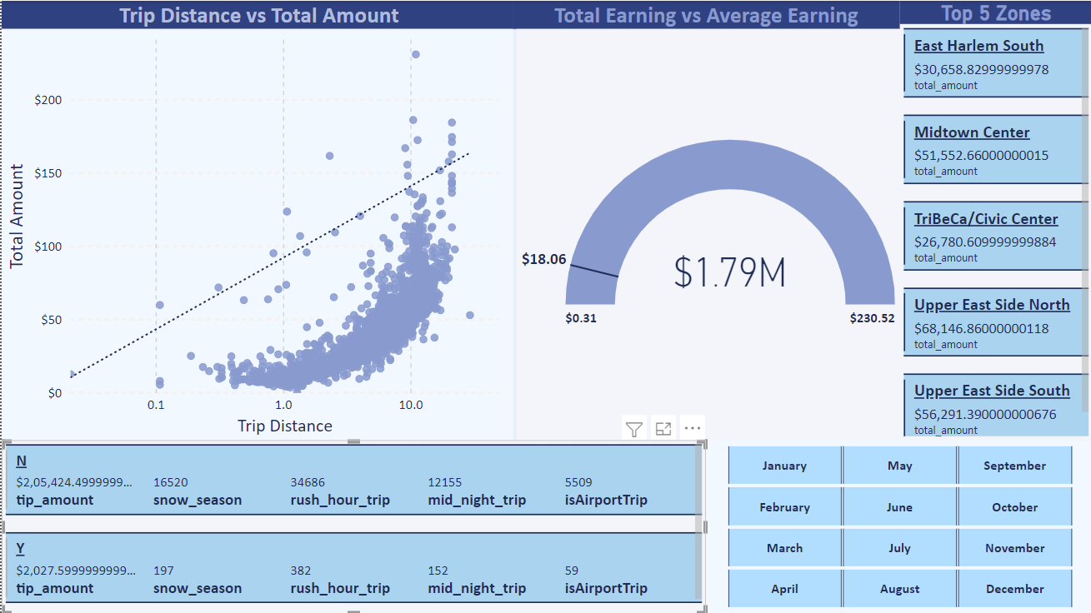

Slide 18
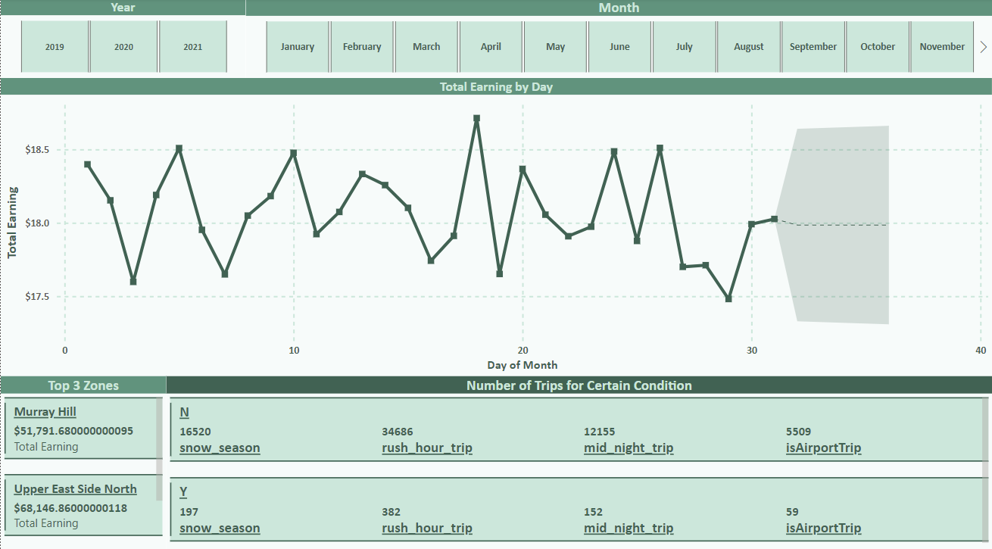

Slide 19
THANK YOU!!

